Slide 1




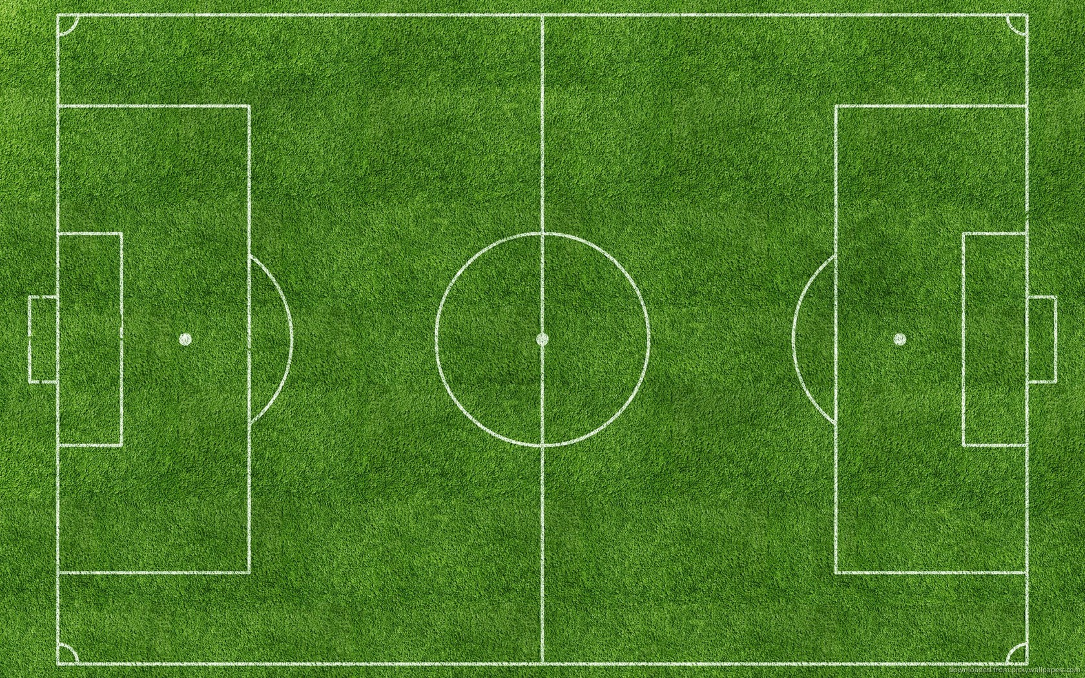

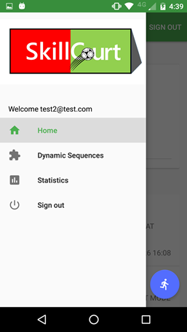
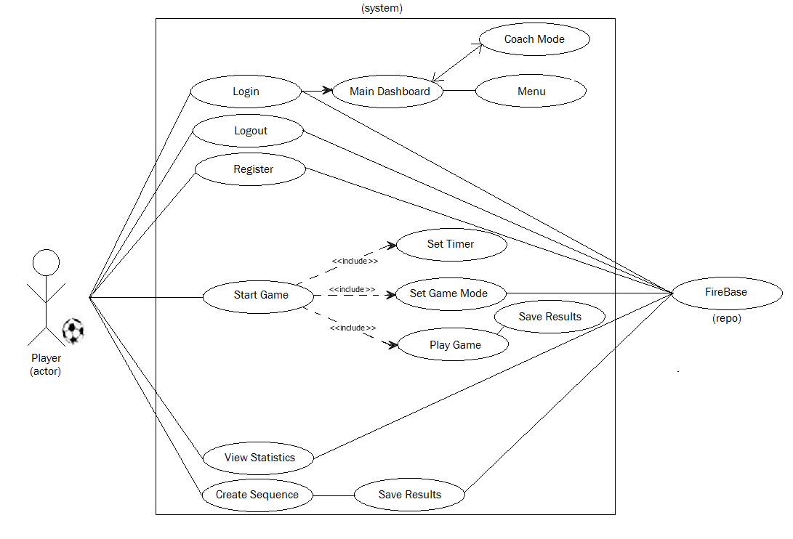


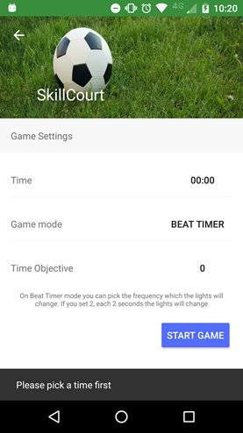


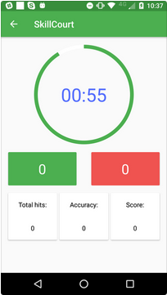



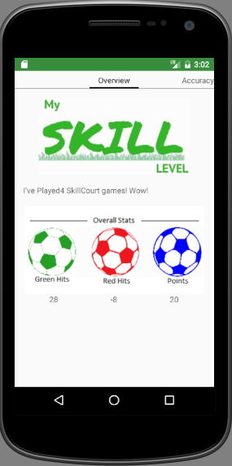
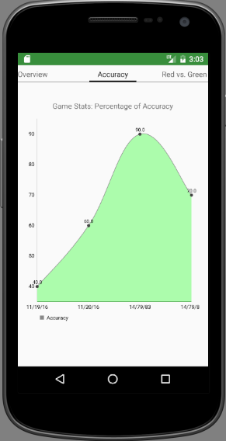
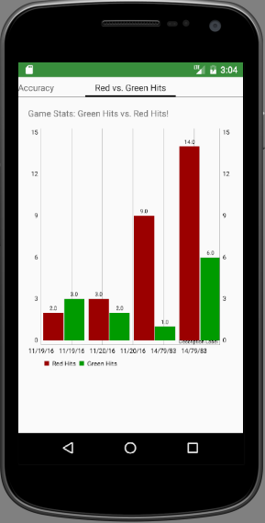
SkillCourt
Technology is advancing at an exponential rate in all aspects of our lives, including sport. The drive for success in Soccer has led coaches and players on the hunt for the best possible path towards efficiently and effectively improving performance.
,
.
SkillCourt is an advanced training tool specialized at not only emulating the most customizable of game-like environments, but also provides a powerful platform for storing, tracking, and analyzing a players performance and progress.
Newly developed Android application fully equipped with:
Wireless control of the LED encasing lights of the rebounding boards and obtaining feedback from attached buttons
Customizable game modes feature
Optional Coach/Team control
Statistical historical analysis
Contributions
Menu Option for statistics viewing
Communication with database
Swipeable View of graphicals of:
-Overall counts (icons)
-Accuracy (line)
-Hits comparison (bar)
..for my contributions:
.
Players should be able to view Statistics page via button on menu
Coaches should be able to view Statistics page of players by userID
Graphs should display “No Data” if the player has no results saved
Swipable views of each graphical:
Icons representing overall counts for games played
Line Graph based on real time dates & scores per game played
Bar Graph based on real time dates and red vs. green hits
.
.
Software Components:
Android IDE (i.e. Android Studio)
FireBase (cloud-based repository)
Arduino IDE
Wireless connectivity
Hardware Components:
Android Device
Arduino
Sensor/button(s)
Rebounding Pad(s)
LED(s)
Test Case 1
○ Purpose: Test accuracy of database retrieval for a player that saved results
○ Precondition: User plays new game and saves results. Then rechecks “Stats”
○ Expected Result: The graphs are all created with new score intact
○ Actual Result: Same as expected. Status: PASS
a
Test Case 2
○ Purpose: Test functionality of page if player has not saved game results
○ Precondition: Player that has not saved any game data clicks “Stats” button
○ Expected Result: The graphs are created but with no lines/bars/counts.
○ Actual Result: Same as expected. Status: PASS
Technology’s integration into athletics is being embraced in many forms and SkillCourt is no expectation. This robustly capable, yet easy-to-use App, will serve as the perfect companion for a hard- working player and the most effective of weapons for a well-rounded coach.
,
SkillCourt paves the way for a new era in the development of futbol players of all skill levels and will undoubtedly open up a world of untapped resources from a coaching aspect, as well!
The material presented in this poster is based upon the work supported by Pedro Carrillo, Jofran Duran, Rolando Ramos. I am thankful to the help that I received from my group.
Notes:
1

